Slide 1

Chapter 6: Call by Reference

Slide 2
Call-by-reference
Call by reference.
Formal parameter points to the actual parameter.
Assembly level
Must push the address of the actual parameter onto the stack.
The called subroutine must use the value on the stack as an address.
C++ (but not C) provides call-by-reference

Slide 3
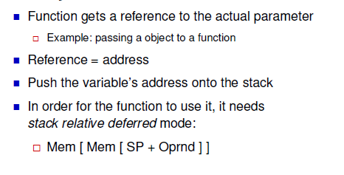
Call-by-reference

Slide 4
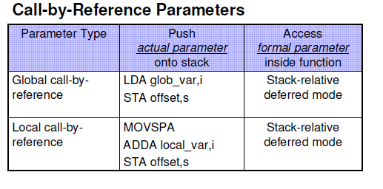
Call-by-reference

Slide 5
Indexed Addressing and Arrays
Assembly level: calling
Place address of the formal parameter onto stack.
Use the symbol with immediate addressing
Assembly level: called
Access the formal parameter using stack-relative deferred addressing.

Slide 6
Stack-relative deferred addressing
Oprnd - Mem[Mem[SP + OprndSpec]]
Mem[SP + OprndSpec] becomes the address that is used to find the operand
Addressing mode identifier: sf
; this instr uses stack-relative deferred addressing to
; load the acc
LDA r, sf
; this instr takes the result and stores it in a local var on
; the stack
STA temp,s

Slide 7
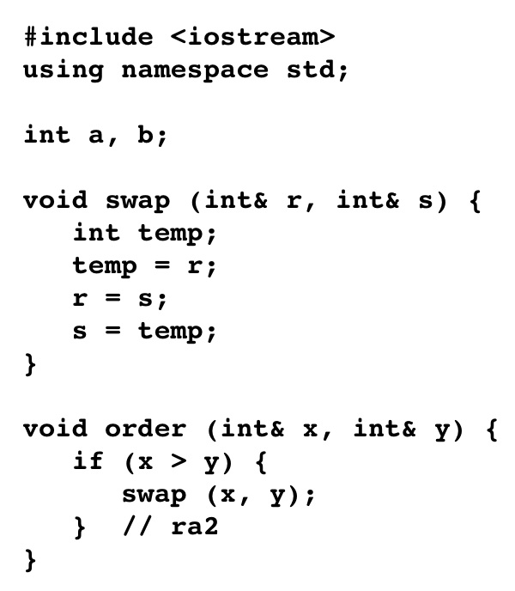
A procedure call with a parameter called by reference at Level HOL6 and Level Asmb5 fig. 6.27

Slide 8
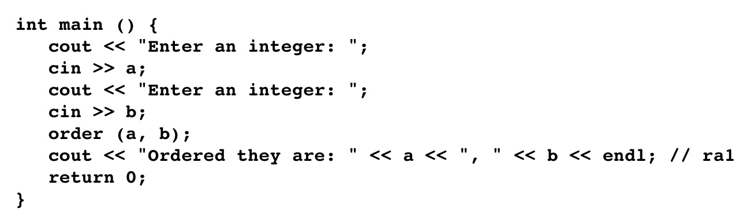
A procedure call with a parameter called by reference at Level HOL6 and Level Asmb5

Slide 9
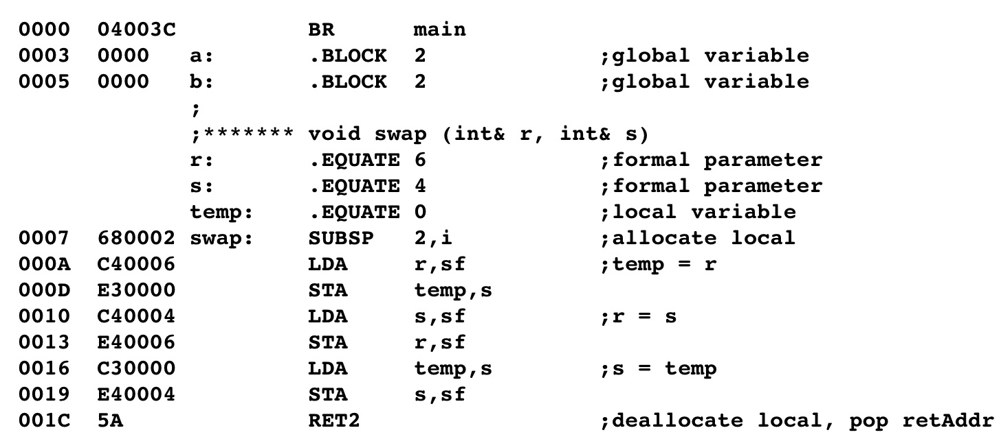
A procedure call with a parameter called by reference at Level HOL6 and Level Asmb5 (Cont’d)

Slide 10
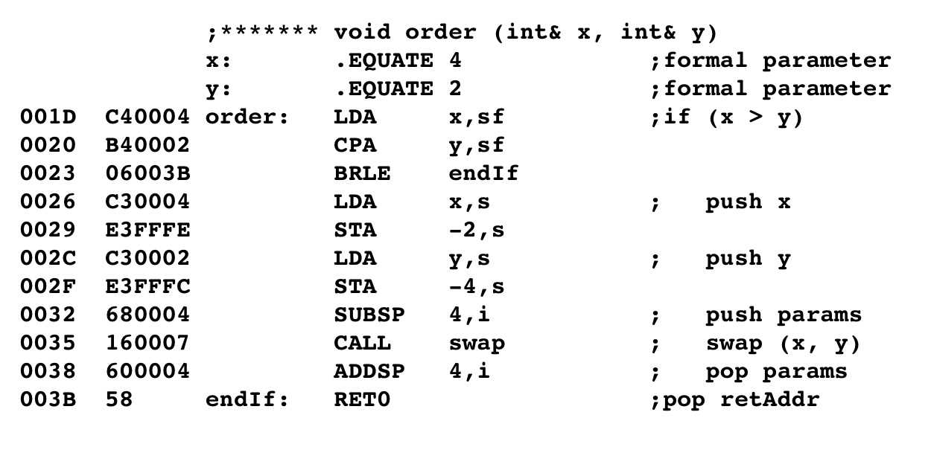
A procedure call with a parameter called by reference at Level HOL6 and Level Asmb5 (Cont’d)
load x using stack-deferred
addressing. Compare with y
using stack-deferred addressing
load x and y from stack (they
contain addresses) to new
position on stack (for next call)

Slide 11
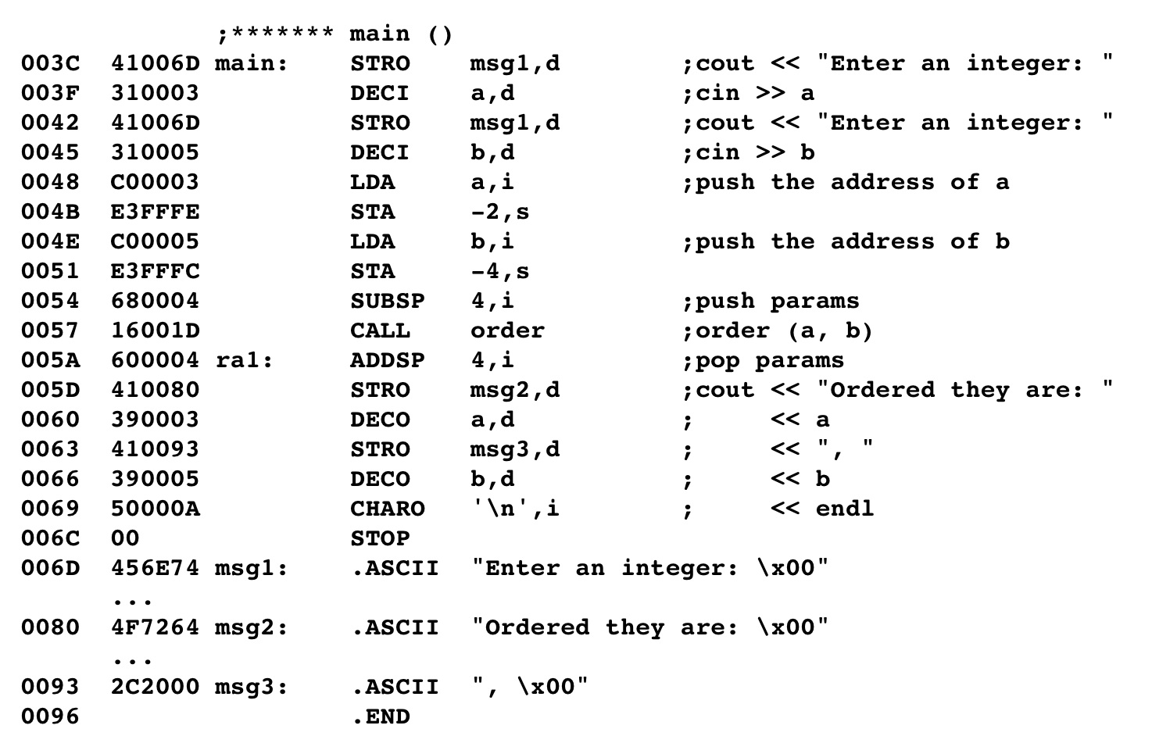
A procedure call with a parameter called by reference at Level HOL6 and Level Asmb5 (Cont’d)
load address of a and b
onto the stack; use
immediate addressing

Slide 12
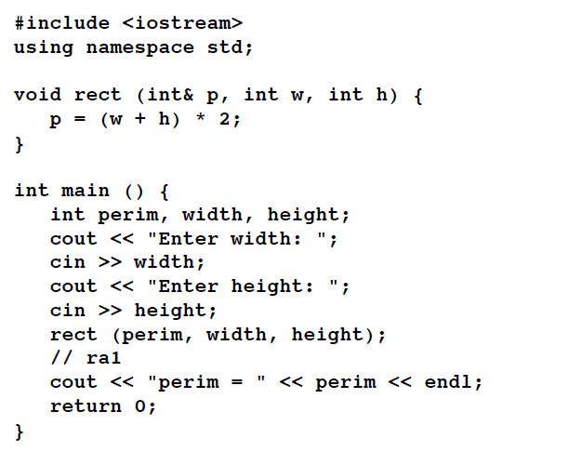
Call-by-reference with local variables fig. 6-29

Slide 13
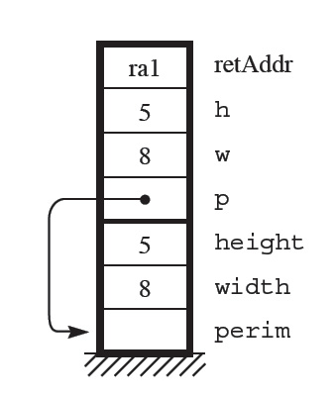
Call-by-reference with local variables
Problem: the parameter p is a reference variable
But the variable it points to, perim is on the stack
How can we point to the stack?

Slide 14
Call-by-reference with local variables
Cannot load the name with immediate addressing
LDA perim, i
STA -2, s
perim is 4, the distance from the top of the stack
This is not the address of perim!
Need to load the stack address to the proper place on the stack for the parameter perim

Slide 15
Call-by-reference with local variables
New instruction: MOVSPA
Moves the contents of the SP to A: A ←SP
There is no MOVSPX; cannot move SP to X
To load a reference variable from the stack to the stack:
MOVSPA
; address must be offset from top of stack
ADDA perim, i
STA -2, s

Slide 16
Call-by-reference with local variables
To use a reference variable:
; stores the contents of the accumulator
; into a reference variable
STA p, sf

Slide 17
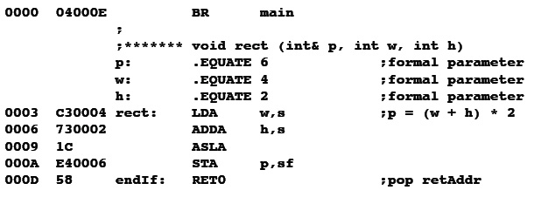
Call-by-reference with local variables
Store the accumulator in the referenced variable (the var p that is local to main)

Slide 18
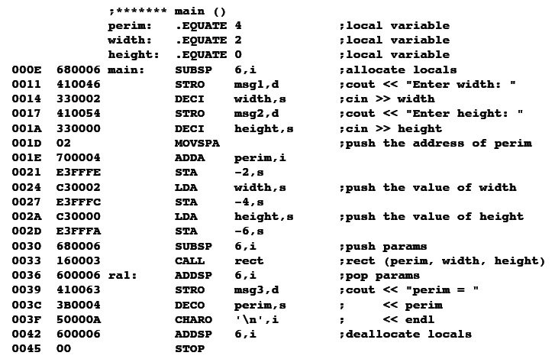
Call-by-reference with local variables
Store the address of the SP into the accumulator
Add the offset so that the address is correct
Store the completed address onto the stack as the first parameter.

Slide 19
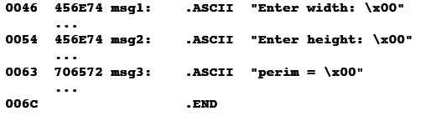
Call-by-reference with local variables

Slide 20
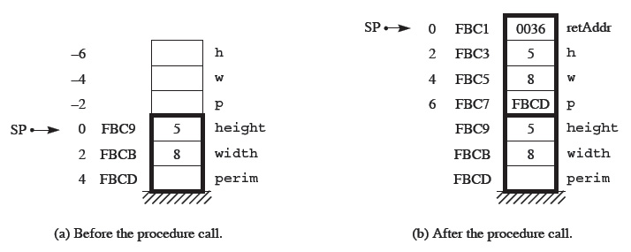
Call-by-reference with local variables
Parameter p contains the stack address of perim

